Slide 1
Building & Deploying a Full-Stack MERN App on Azure
Workshop 1: Introduction & Backend Setup
Gurjot Singh
Graduate Student, School of Computer Science
University of Windsor

Slide 2




Workshop Series Overview
Embark on an 8-week journey to master full-stack development and cloud deployment.
8-Week Hands-on Journey
Build a MERN Todo App
Structured, practical sessions designed for effective learning.
Develop a complete, real-world application from scratch.
Docker, CI/CD & Azure
Beginner Friendly
Learn modern deployment practices and cloud services.
No prior cloud experience required, just basic JavaScript.

Slide 3

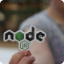


What We Are Building
A robust, scalable Todo application using industry-standard technologies.
Frontend: Next.js
A powerful React framework for modern web applications.
Backend: Express.js + MongoDB
Fast, unopinionated Node.js framework with a flexible NoSQL database.
Deployment: Azure App Service
Leveraging containers for seamless, scalable hosting.
CI/CD: Azure DevOps + ACR
Automated workflows for continuous integration and deployment.

Slide 4

High-Level Architecture
Understanding the flow of data and services in our MERN stack application.

Slide 5
Today's Goals (Workshop 1)
Setting the foundation for our backend development.
1
Understand the Full System
2
Set Up Backend Project Structure
Grasping the interconnected components of our application.
Organizing our files for efficient development.
3
Create a Basic Express Server
4
Run Backend Locally
The core of our backend, handling requests and responses.
Verifying our server is operational on our development machine.

Slide 6

What Is a Backend?
The backend is the "brain" of your application, working behind the scenes to power its functionality.
Handles complex business logic and calculations.
Manages data storage and retrieval from databases.
Exposes secure APIs for frontend applications to communicate with.
Operates independently of the user interface, ensuring robustness.

Slide 7

What Is an API?
An Application Programming Interface (API) acts as a messenger, allowing different software components to interact.
Enables communication: The crucial link between your frontend and backend.
Standardized requests: Defines how clients can request information or services.
HTTP methods: Uses verbs like GET (retrieve), POST (create), PUT (update), and DELETE (remove) for operations.

Slide 8




Backend Tech Stack
Our chosen tools for building a high-performance backend.
Node.js
Express.js
A powerful JavaScript runtime for server-side development.
A minimal and flexible Node.js web application framework.
REST APIs
MongoDB
Architectural style for building networked applications.
A document-oriented NoSQL database (covered in later sessions).

Slide 9
Live Coding: Backend Setup
Key Steps
Follow along as we set up our backend from scratch.
Initialize Node Project: npm init -y
Install Express: npm install express
Create server.js: Our main backend file.
Add /health endpoint: A simple test for server status.
// server.js const express = require('express'); const app = express(); const port = 5000; app.get('/health', (req, res) => { res.send('Backend is healthy!'); }); app.listen(port, () => { console.log(`Server running on port ${port}`); });

Slide 10
What's Next?
Prepare for deeper dives into database integration and API development.
1
2
Database Integration
MongoDB Setup
Connecting our Express app to MongoDB.
Learn to configure and interact with our NoSQL database.
3
4
CRUD APIs
Testing with Postman
Implementing Create, Read, Update, and Delete functionalities.
Ensuring our APIs work as expected.

Slide 11
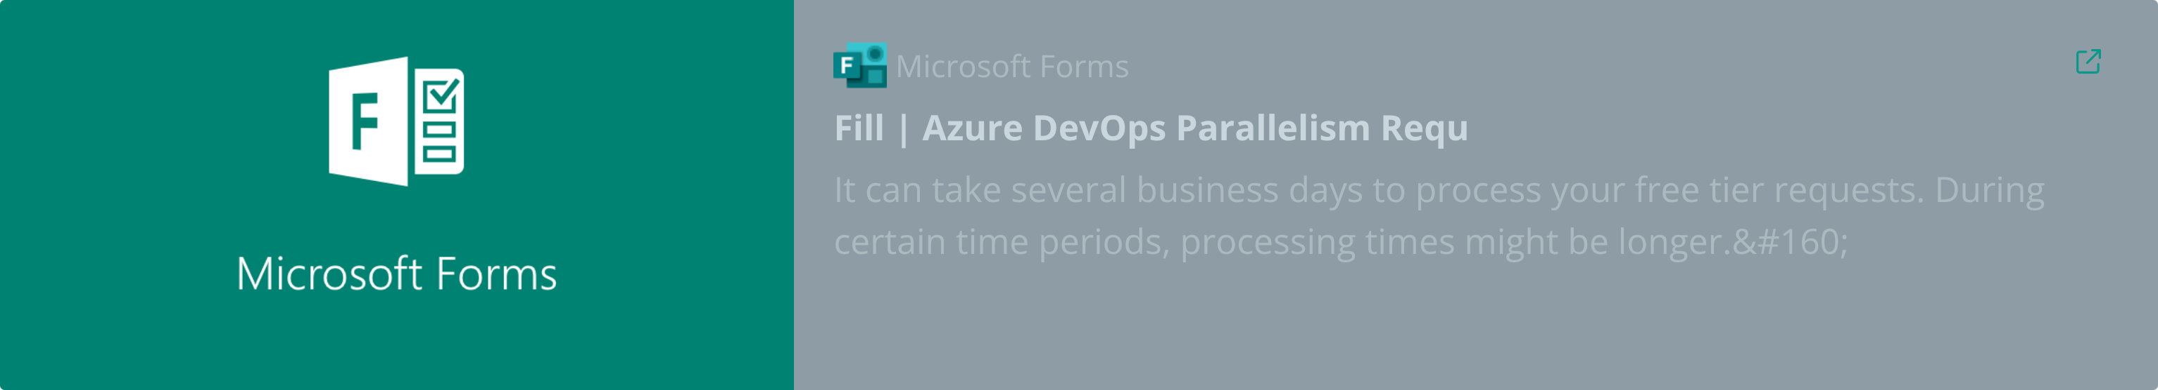
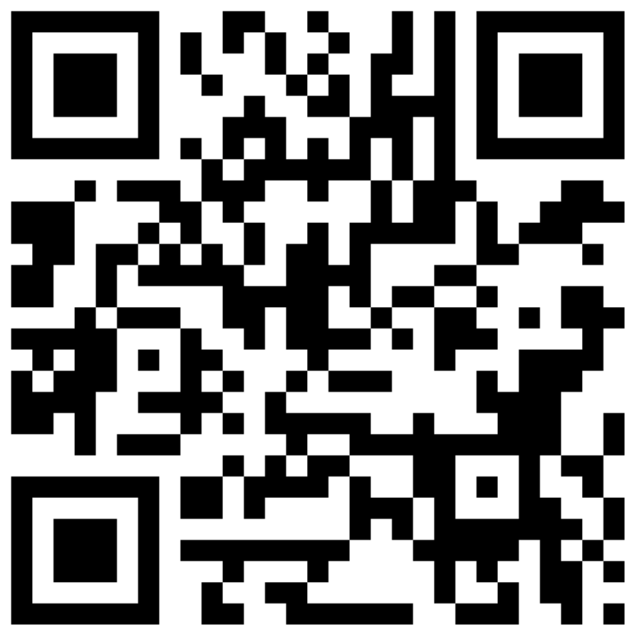
Azure DevOps Parallelism Request Form

